Slide 1

Swift-Uav
Scientific Workhorse for In-flight Field Tests – Unmanned Aerial Vehicle

Slide 2
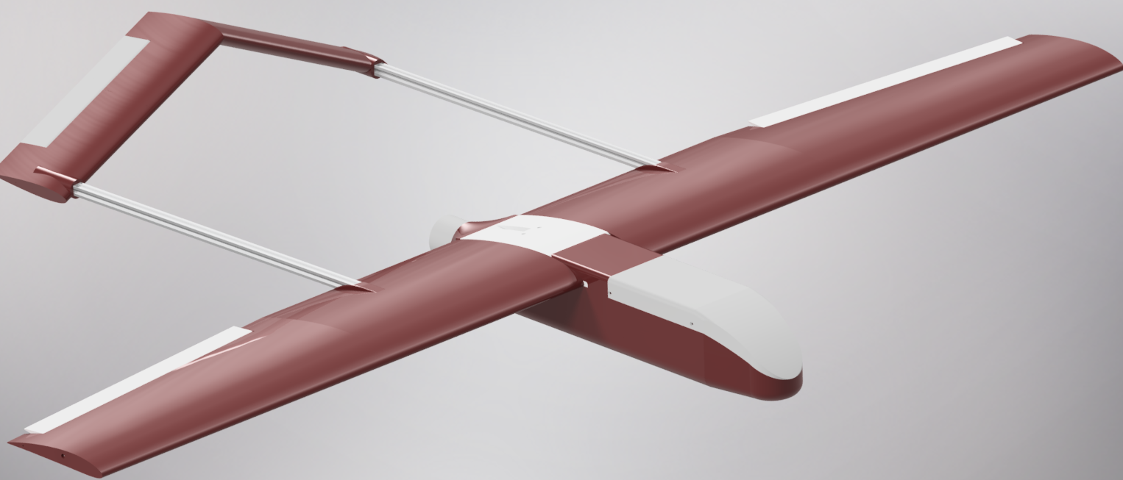
Mission Statment
Develop a UAV to serve as a Scientific Workhorse for In-Flight Testing (SWIFT – UAV)
Make aerial scientific research accessible by developing an affordable, open-source, easy to manufacture UAV capable of carrying a diverse set of scientific payloads

Slide 3
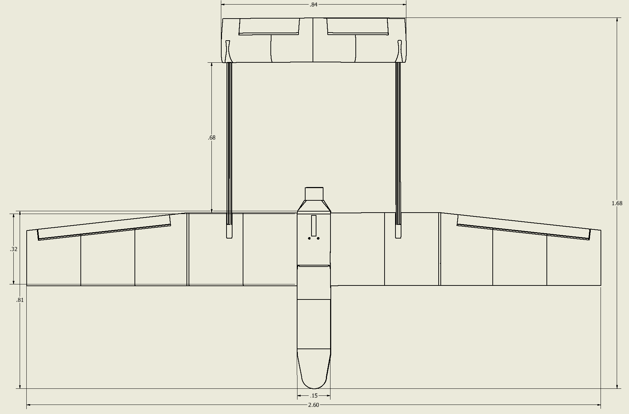
Overview of Design
High Wing, twin-boom mono-propeller pusher configuration was selected for its:
aerodynamic stability
High wing promotes “self-righting” in the roll axis
aerodynamic efficiency
No prop-wash over wings
structural integrity
“Box” shape enables multiple redundant struts
built-in safety envelop
Booms act to protect end users from the propellers path
ease of payload mounting
The entire front of the plane is clear to mount almost anything

Slide 4
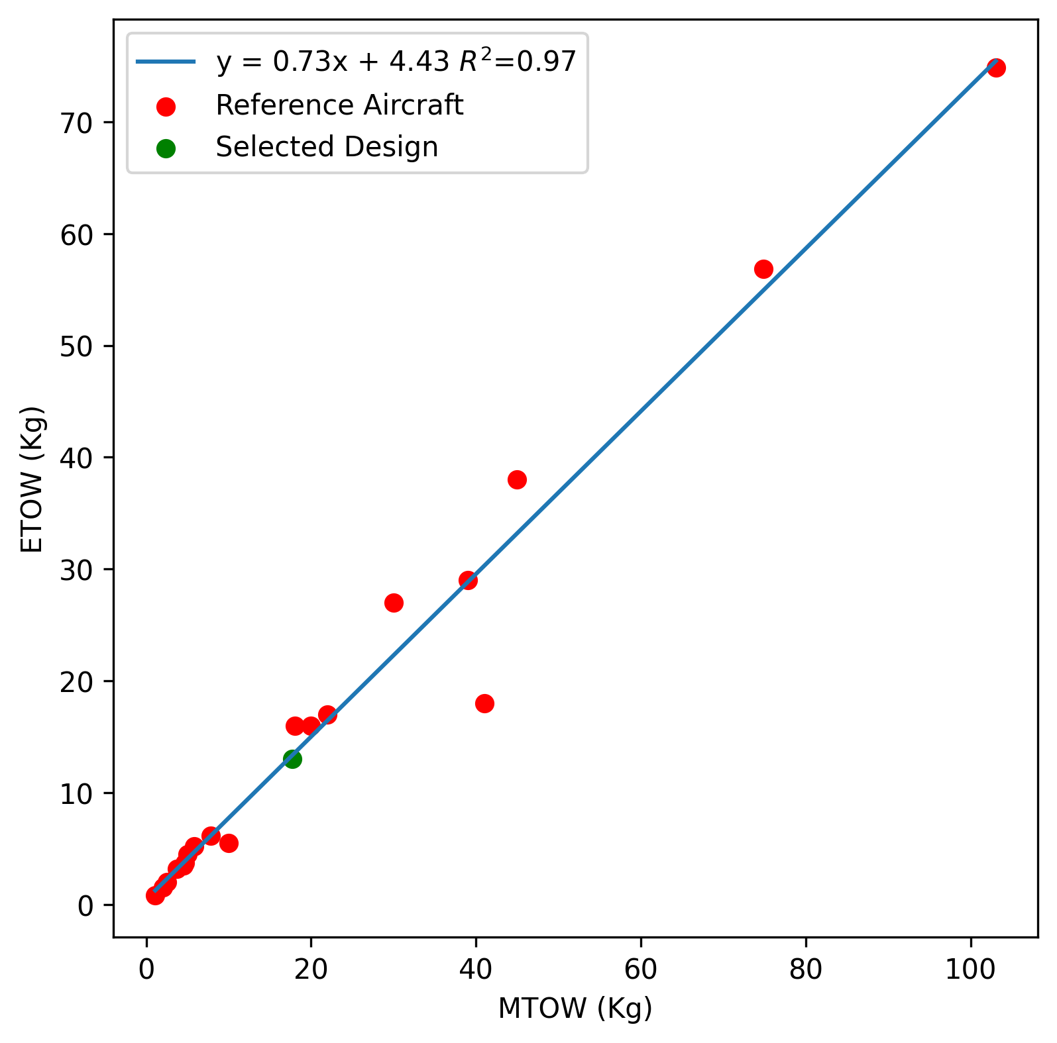
Targeted Design Specifications
First class estimations of performance done using specifications of similar aircraft in conjunction with classical aerodynamic analysis approaches
Empirical methods exist to estimate most performance metrics of aircraft
Conservative estimations

Slide 5
Aerodynamics
Wing first design
Plane was designed around the wing
Classical aerodynamic wing analysis was performed to “bound” the aspect ratio, airfoil, wing length etc.
Wing Specifications were then chosen to be in line with reference aircraft

Slide 6
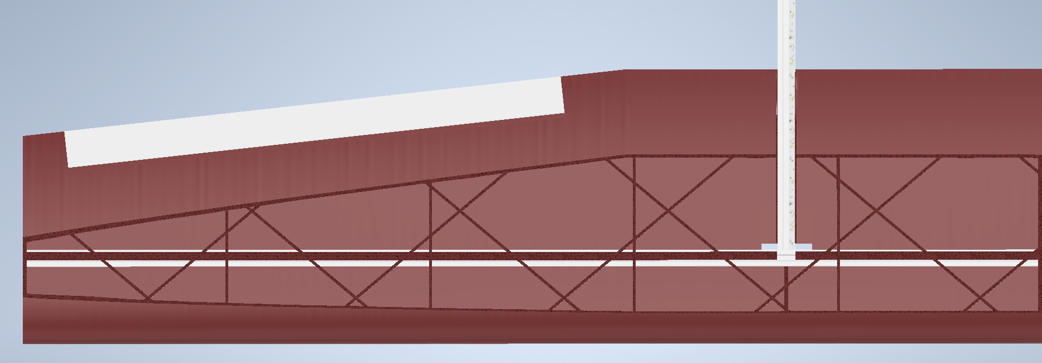
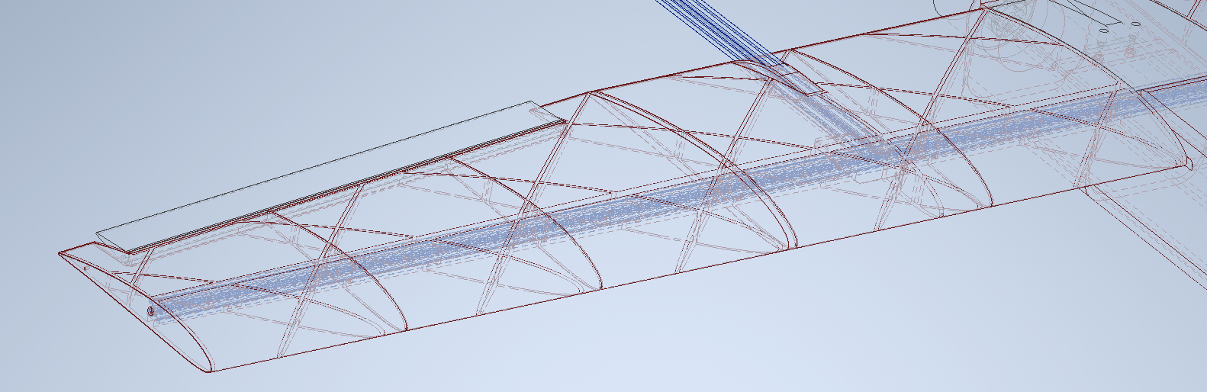
Structural
Aluminum extrusion act as spars
Aluminum is very over-spec relative to the wing loading
Diagonal Ribs are added to transfer load from wing skin to the central spar
Skin is very thin walled, 0.8mm
Since wing has to be printed in section the walls don’t act to carry much shear flow between sections
Further Design optimization need to better handle torsional loading between sections
For now, the wing is glued to circumvent this

Slide 7
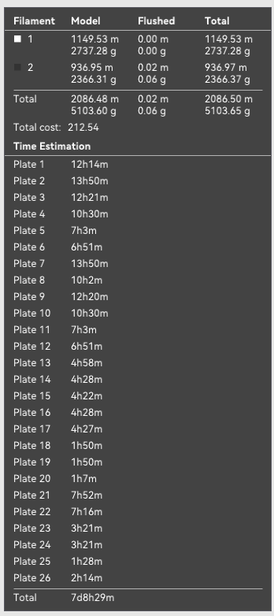
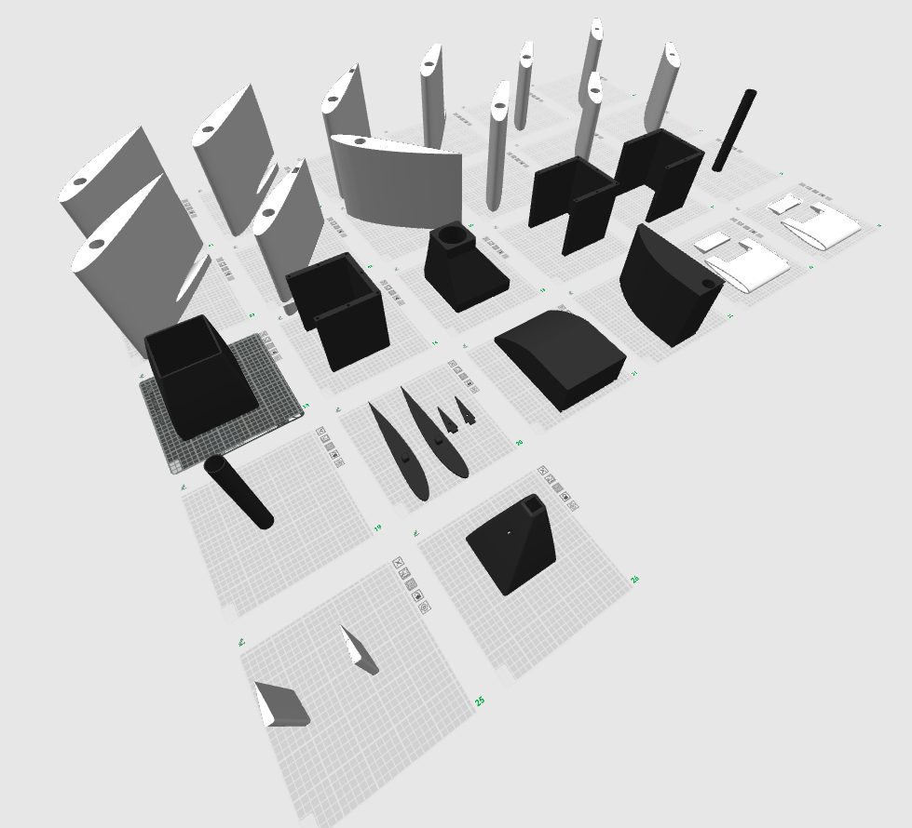
Manufacturing
Almost entirely 3D-printed design enable trivial manufacturing
In conjunction with the aluminum extrusion system used, almost no manual manufacturing is required
Cut 20/20
Screw/glue parts together
Fig 1: V1.2 in slicer software with estimated print time

Slide 8
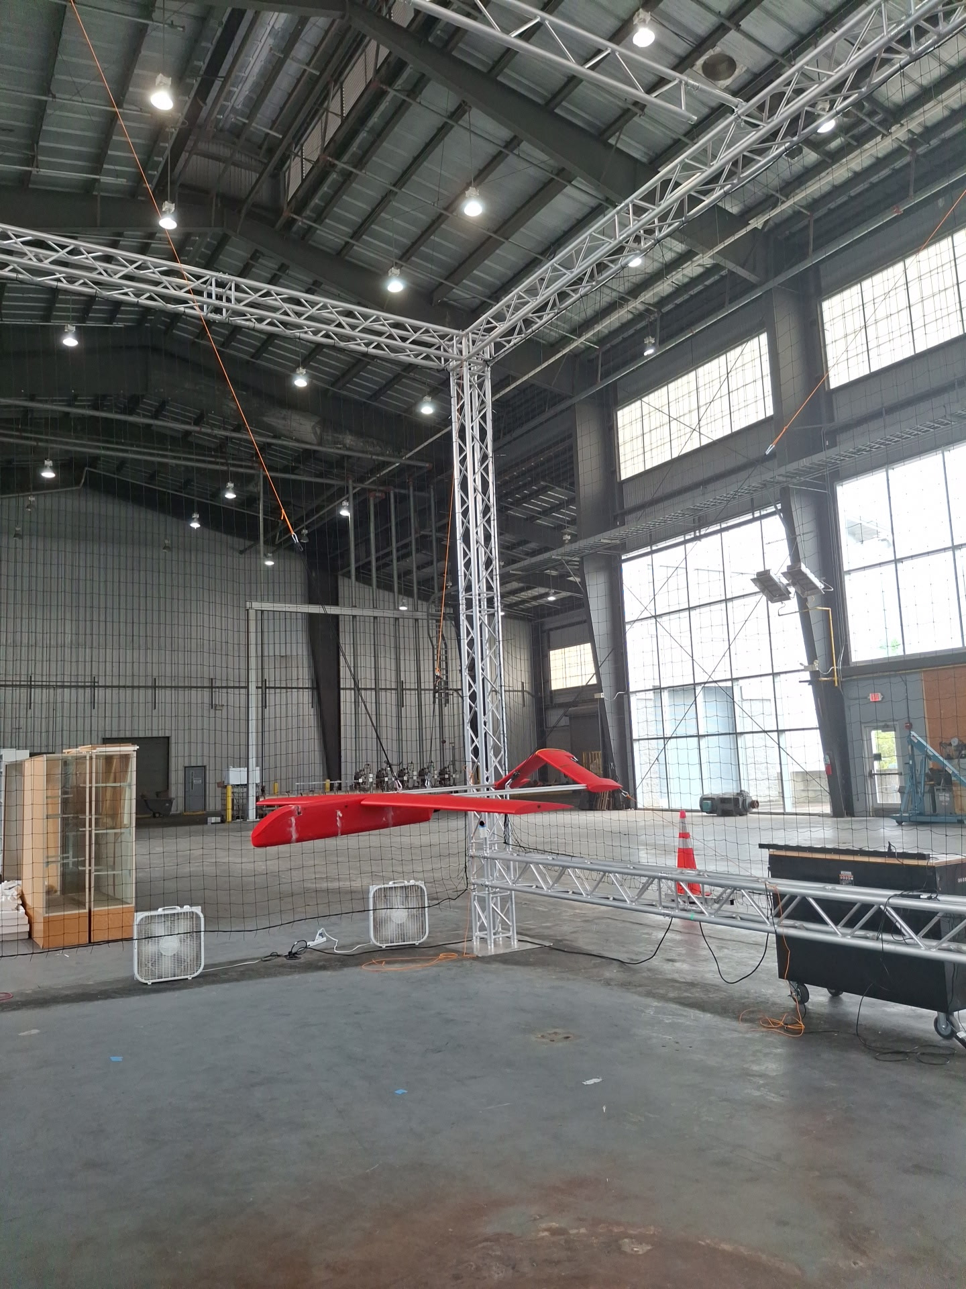
“Iron Bird” Testing
Preliminary iron bird testing will soon be conducted to validate electrical systems under load

Slide 9
Timeline
V2.x Detailed Design
V3.x Ground Optimization
V4.x Flight Tests
Design Landing Gear
Design Control Surfaces
Design Avionics Bay
Wing Structural Optimization
Aerodynamic Optimization
Validate Avionics Layout
Avionics Optimization
Manufacturing Optimization
High Speed Taxi
V1.x Preliminary Design
First Class Estimations of Flight Characteristics
Preliminary complete Design
Manufacturing Procedure Validation
Detailed Structural Design
Detailed Aerodynamic Design
Fuselage Structural Optimization
Short Flight Tests
Endurance Flight test
Full “Iron Bird” Test
Preliminary Avionics Validation

Slide 10
Thanks!
Mateo Garcia and Matthew Burnett

